Slide 1

Micro-frontend

Slide 2
Micro-frontend
Challenge:
Modern web applications are becoming big and more complex and sometimes managed by different teams.
Application might have features developed by different teams and wants to release only certain features into production before delivering the entire application.
How to manage different teams, different release timelines if for one repo?

Slide 3
React Micro-frontend
Solution:
Micro-frontends are small applications divided by subdomain or functionality working together to deliver a larger application.
Micro-frontends architecture can be implemented with Angular,React and Vue js.

Slide 4
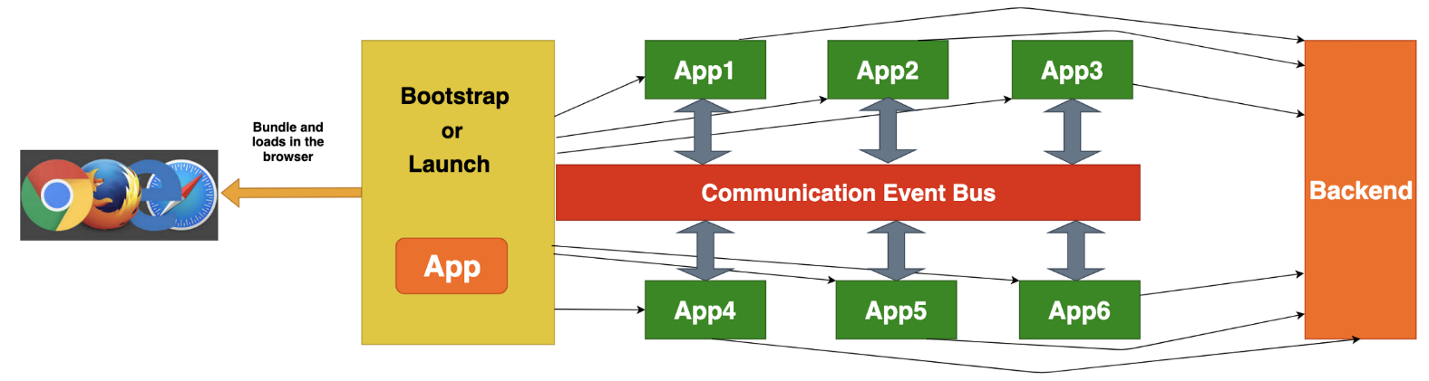
Micro-frontend

Slide 5
10 Micro-frontend Advantages
Apps are small
Apps are independent
Apps are easier to understand
Apps are easier to develop and deploy
Apps are easier to test
Apps development becomes faster
CI/CD Becomes easier
Independent Stacks and versions
No Shared Code
Can change architecture easily without touching old one

Slide 6
Features of Micro-frontend
Each frontend represents a specific feature or subdomain of the entire application
Each frontend can be implemented with a separate team.
Each frontend can be implemented with different technology.
Its independent of each other.
Each Frontend can be owned by a single team.

Slide 7
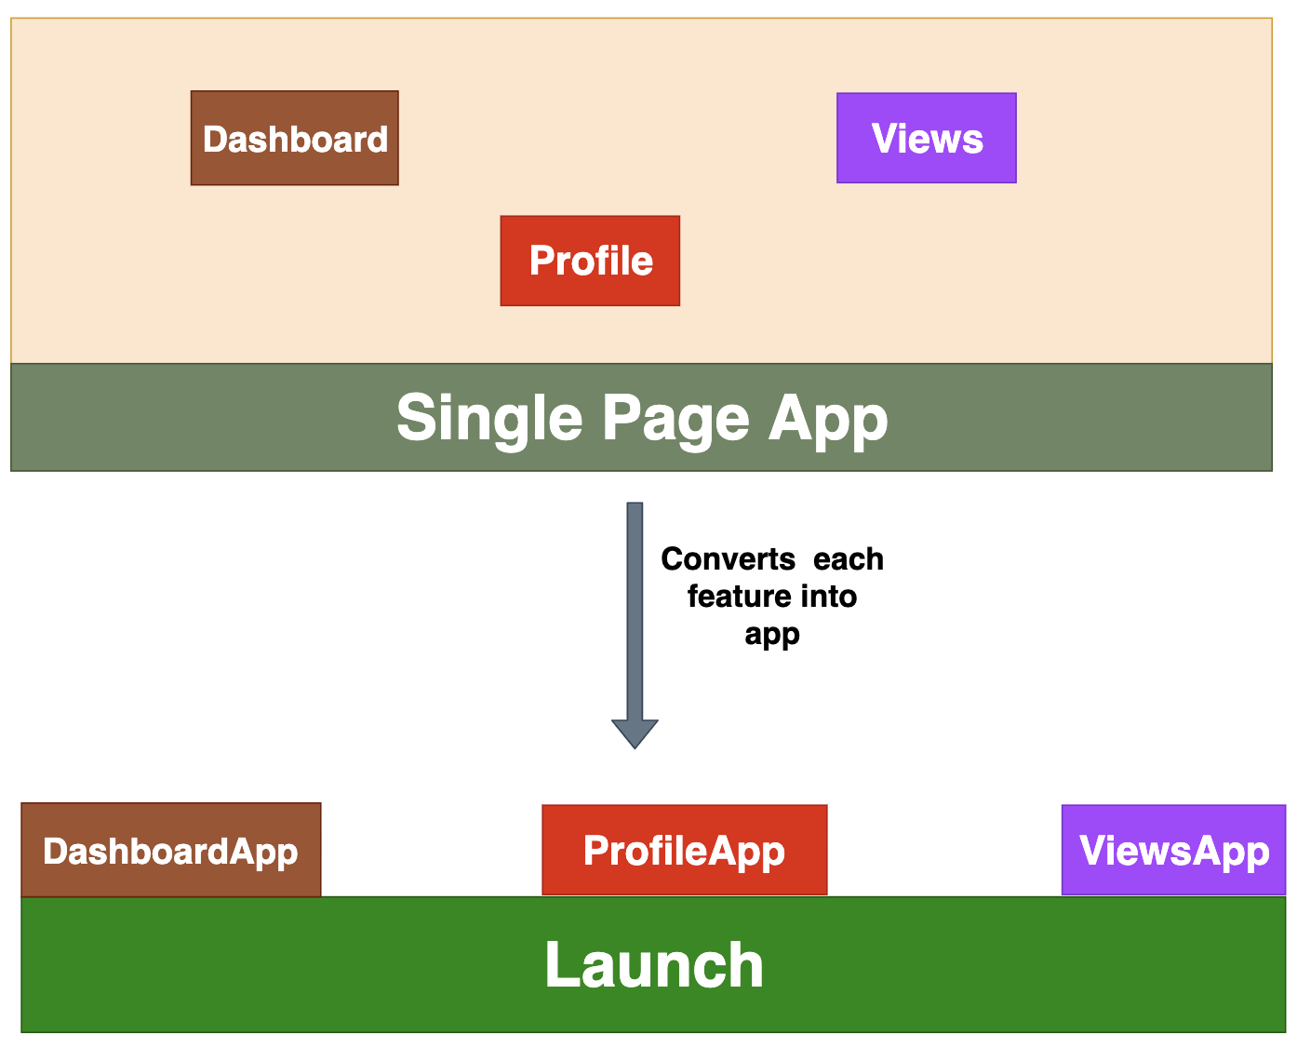
How do we Split?
By Feature
This is the most common method since we can easily divide the features of the app. For example, if there are three features for the app Dashboard, Profile and views we can make each feature as a separate app and mounts and unmounts in the DOM with the help of Launch.js. This Launch.js can be a separate app or just a simple javascript app.

Slide 8
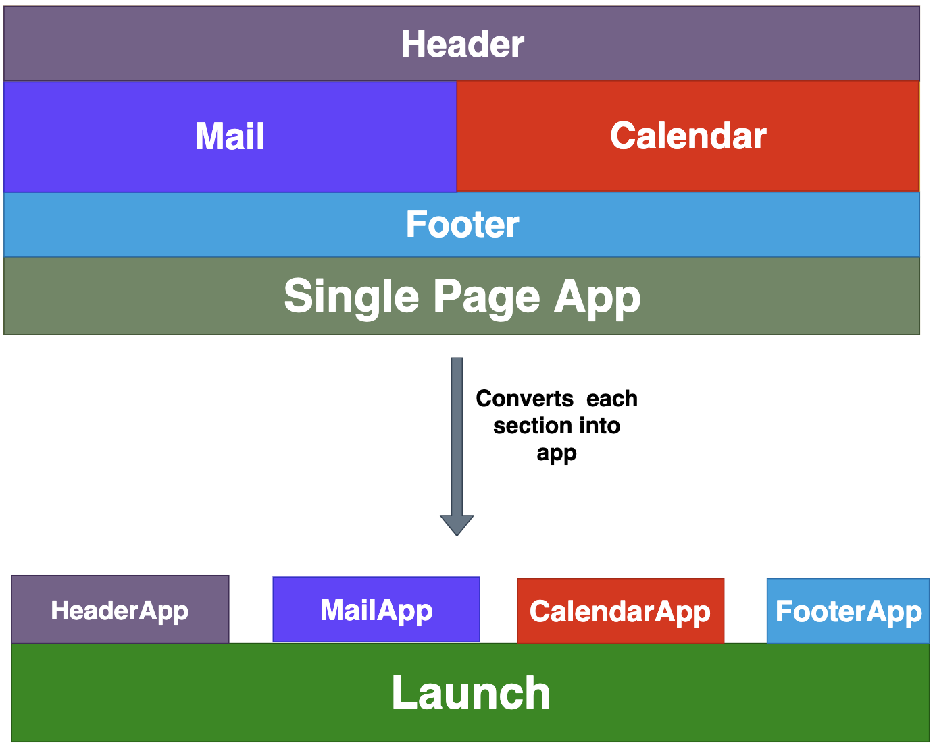
How do we Split?
By Sections
Some of the apps have so much functionality with each section, for example, Coinbase, Gmail, etc. We can implement each section as a new app in that scenario.
.

Slide 9
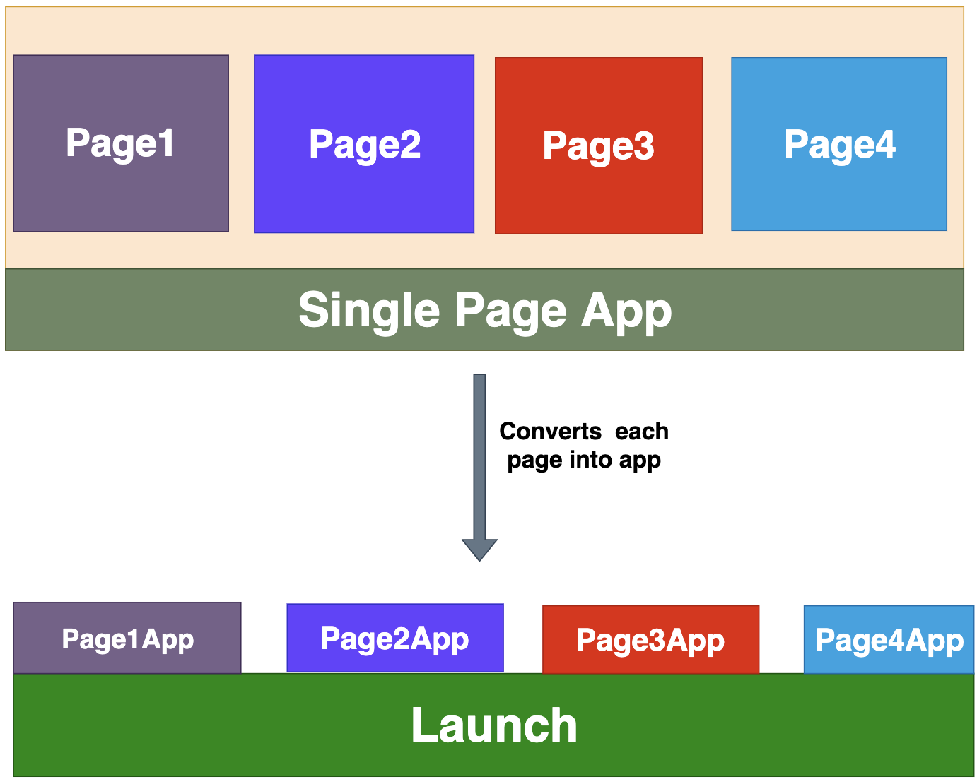
How do we Split?
By Pages
Some app’s functionalities are divided by page. Each page has some functionality that can be independent. We can divide these apps by page.
.

Slide 10
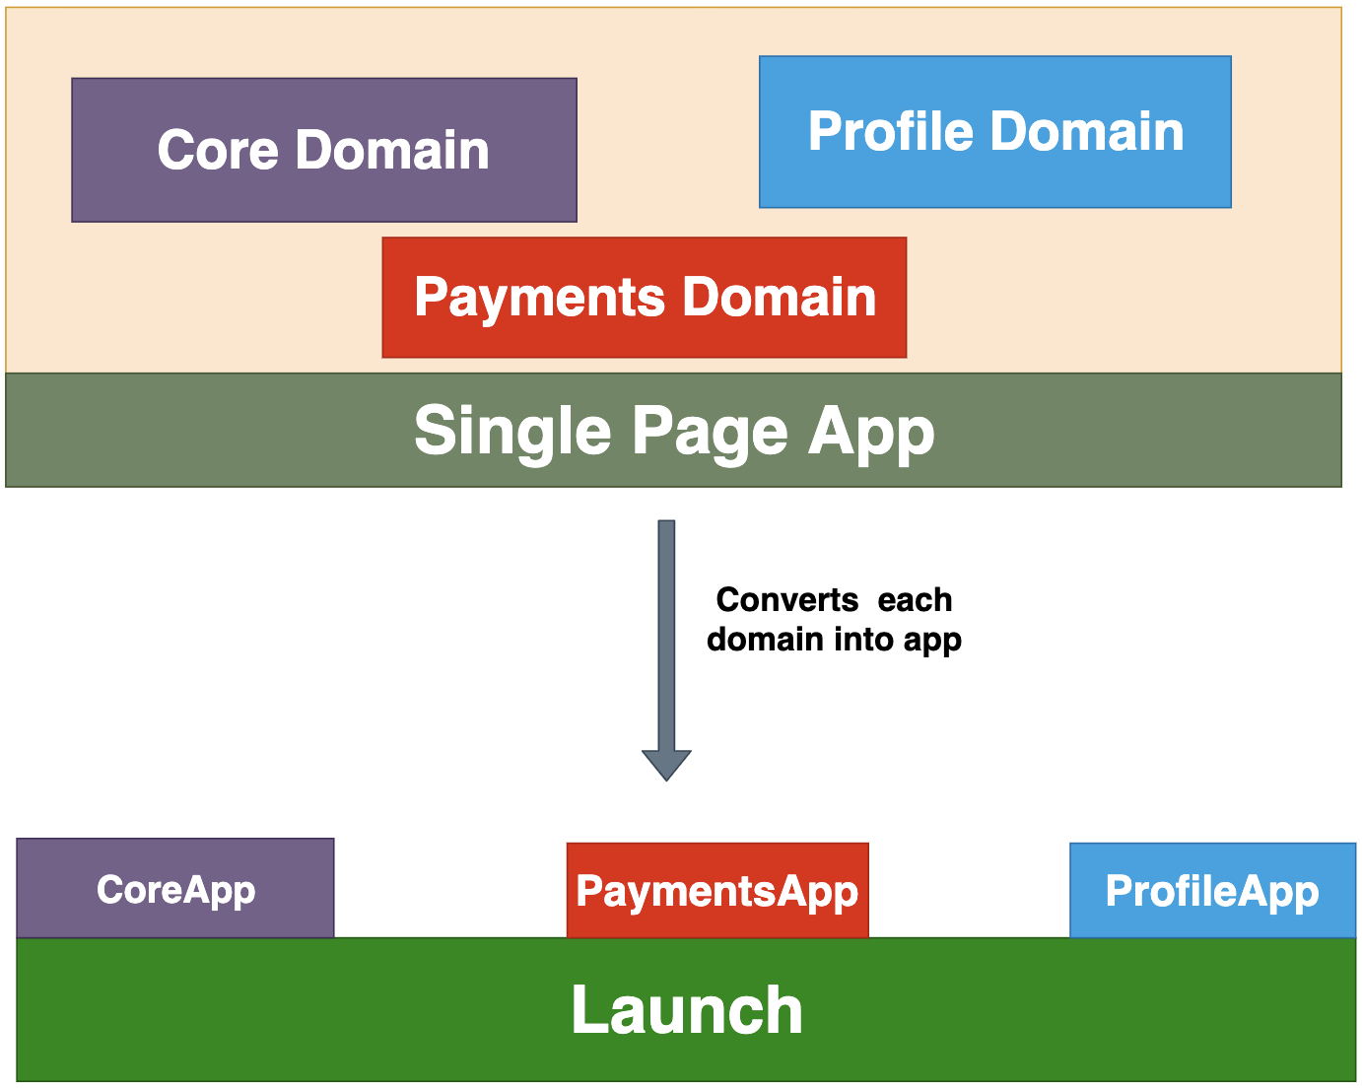
How do we Split?
By Domain
Splitting app based on the domain is also one of the most common approaches.
.

Slide 11
Different approaches to Micro-Frontends
Webpack Module Federation
Iframes
Through NGINX
Web Components
React Component Libraries
Monorepos
Customized Orchestrator

Slide 12
Micro-Frontend Frameworks
single-spa
frint.js
single-spa
single-spa is a javascript framework for front-end microservices and can be implemented with all three popular frameworks/libraries such as Angular, React, and Vue.js. It can lazy load the applications based on the need.

Slide 13
Micro-Frontend Frameworks
single-spa
frint.js
Frint js:
frint.js is a Modular JavaScript framework for building Scalable & Reactive applications. It doesn’t support Angular yet but it supports React. For building a reactive application from scratch, this is the framework.
Demo : https://react.microfrontends.app/

Slide 14
Micro-Frontend Frameworks
git clone https://github.com/react-microfrontends/root-config.git
cd root-config
yarn install
yarn start
open http://localhost:9000
cd root-config and npm start

